Slide 1
Pirate Game Ryan Westwood 12th May 2020
CMP4274 3D Game Programming
BSc (Hons) Computer Games Technology
Birmingham City University, Faculty of Computing, Engineering and the Built Environment

Slide 2
Introduction
The task is to create a 3D 17th century pirate game using Unity 2019.

Slide 3
Aims
To implement the following features:
Moving clouds
1st and 3rd person
2 Unique enemies
Enemy ships can fire on player
Enemy ships show patrolling behaviour
Implementation of different visual effects
Functional storm
Audio
To implement the following features:
Moving clouds
1st and 3rd person
2 Unique enemies
Enemy ships can fire on player
Enemy ships show patrolling behaviour
Implementation of different visual effects
Functional storm
Audio

Slide 4
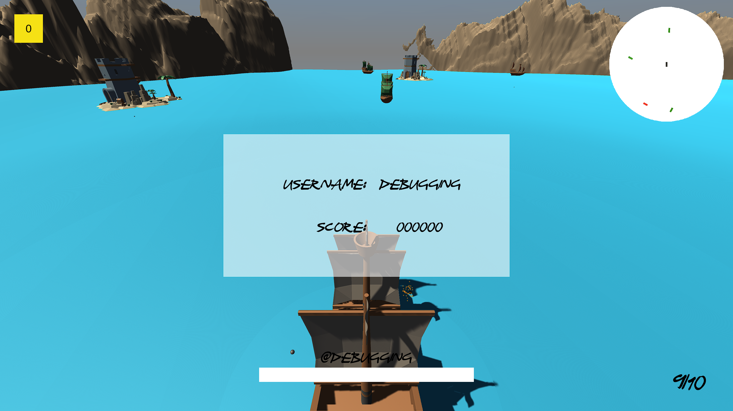
Game
[I]
[H]
[A]
[B]
[F]
[G]
[C]
[E]
[D]
Figure 1: Gameplay. [A] Gold rewards. [B] Islands. [C] Water. [D] Player health. [E] Score. [F] Enemies. [G] Minimap. [H] Terrain. [I] Skybox.

Slide 5
Activity
// Have the video here

Slide 6
Data Structures:
Data Structure | Code
struct Health | Hyperlink
enum Collisions | Hyperlink
Sprite[] bolts | Hyperlink
while( i < 4) | Hyperlink
switch(action) | Hyperlink

Slide 7
Gets/Sets:
Property | Code
public string CharUsername | Hyperlink
public bool LoggedIn | Hyperlink
public int Score | Hyperlink
public float WaveHeight | Hyperlink

Slide 8
Methods:
Method | Code
DisplayHealth(int health) | Hyperlink
DisplayScoreAnimation() | Hyperlink
Register() | Hyperlink
OpenPasswordHelp() | Hyperlink

Slide 9
Encapsulation:
Variable | Code
private string charUsername | Hyperlink
private bool loggedIn | Hyperlink
private int score | Hyperlink
private waveHeight | Hyperlink

Slide 10
Inheritance:
Polymorphism:
ParentHealth
------------------------------------------------------
+ int health
+ UserInterface ui
+ string cannonballID
------------------------------------------------------
+ void LoseHealth(int DamageAmount)
+ void Die()
PirateHealth
------------------------------------------------------
------------------------------------------------------
+ void OnTriggerEnter(Collider other)
+ override void LoseHealth(int DamageAmount)
+ override void Die()
MerchantHealth
------------------------------------------------------
------------------------------------------------------
+ void OnTriggerEnter(Collider other)
+ override void LoseHealth(int DamageAmount)
+ override void Die()
BoatHealth
------------------------------------------------------
------------------------------------------------------
+ void OnTriggerEnter(Collider other)

Slide 11
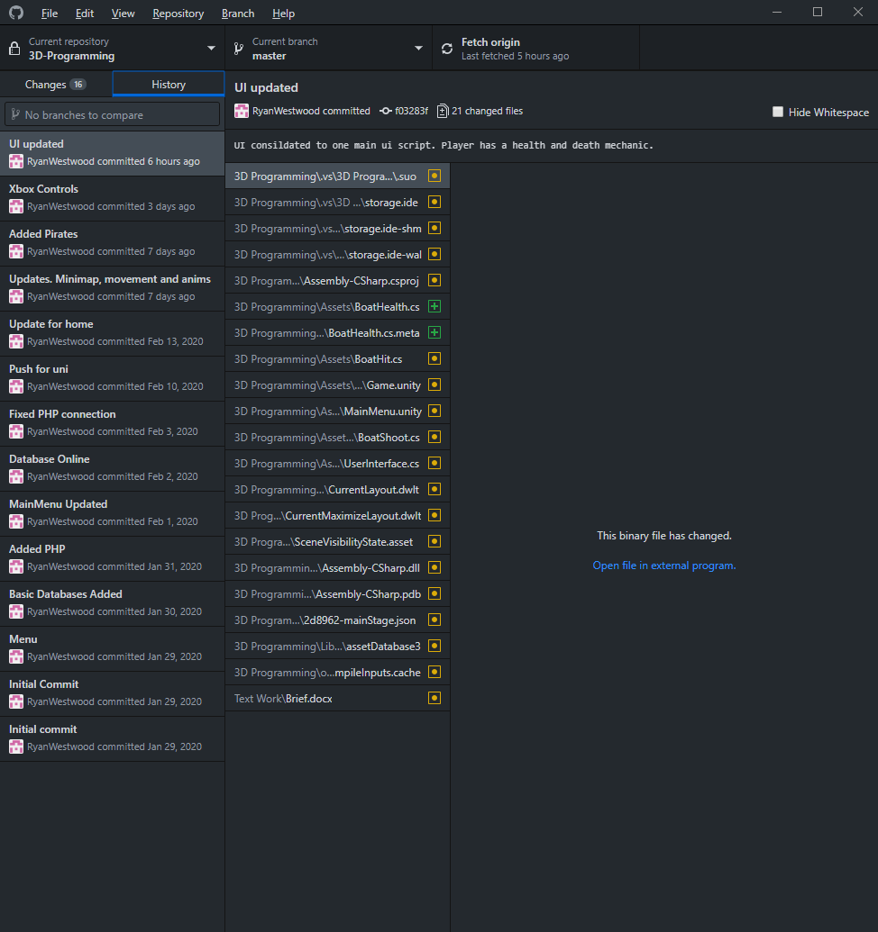
GitHub
Figure 2: GitHub history.

Slide 12
References
Assetstore.unity.com. (2020). FREE Skybox Extended Shader | VFX Shaders | Unity Asset Store. [online] Available at: https://assetstore.unity.com/packages/vfx/shaders/free-skybox-extended-shader-107400 [Accessed 13 March 2020].
Board To Bits Games (2020). Unity + MySQL. [video] Available at: https://www.youtube.com/playlist?list=PL5KbKbJ6Gf99mcmE1ptsn0oXO1_vnKDlS [Accessed 25 Feb. 2020].
Dogan, E. (2020). LowPoly Water - Asset Store. [online] Assetstore.unity.com. Available at: https://assetstore.unity.com/packages/tools/particles-effects/lowpoly-water-107563 [Accessed 25 Feb. 2020].
Kenney.nl. (2020). Kenney • Pirate Kit. [online] Available at: https://www.kenney.nl/assets/pirate-kit [Accessed 25 Feb. 2020].
Pngguru.com. 2020. Free Download | Three Lightning Strikes Collage , Animation Sprite Electric Blue Lightning Game, Tornado Transparent Background PNG Clipart | Pngguru. [online] Available at: <https://www.pngguru.com/free-transparent-background-png-clipart-koqxr/download> [Accessed 25 April 2020].
ZapSplat - Download free sound effects. 2020. Zapsplat - Download Free Sound Effects & Royalty Free Music. [online] Available at: <https://www.zapsplat.com/> [Accessed 25 April 2020].

Slide 13
Any Questions?

